Slide 1

Gain A Competitive Advantage with Cash Balance Plans
A 30-minute Update
Merrill
THE INFORMATION CONTAINED HEREIN IS PROVIDED ONLY FOR THE INTENDED AUDIENCE AND NOT FOR USE WITH OR DISTRIBUTION TO THE GENERAL PUBLIC.

Slide 2
Investing involves risk including possible loss of principal. Information is current as of the date of this material.
Any opinions expressed herein are from a third party and are given in good faith, are subject to change without notice, and are considered correct as of the stated date of their issue.
Bank of America, Merrill, their affiliates, and advisors do not provide legal, tax or accounting advice. Clients should consult their legal and/or tax advisors before making any financial decisions.
FOR FUTUREPLAN BY ASCENSUS USE ONLY – NOT INTENDED FOR USE WITH OR DISTRIBUTION TO CLIENTS OR THE PUBLIC.
Workplace Benefits is the institutional retirement and benefits business of Bank of America Corporation ("BofA Corp.") operating under the name "Bank of America." Investment advisory and brokerage services are provided by wholly owned non-bank affiliates of BofA Corp., including Merrill Lynch, Pierce, Fenner & Smith Incorporated (also referred to as "MLPF&S" or "Merrill"), a dually registered broker-dealer and investment adviser and Member SIPC. Banking activities may be performed by wholly owned banking affiliates of BofA Corp., including Bank of America, N.A., Member FDIC.
MLPF&S makes available certain investment products sponsored, managed, distributed or provided by companies that are affiliates of BofA Corp.
Merrill Lynch Life Agency Inc. (MLLA) is a licensed insurance agency and wholly owned subsidiary of BofA Corp.
Investment products offered through MLPF&S and insurance and annuity products offered through MLLA:
Are Not FDIC Insured | May Lose Value | Are Not Bank Guaranteed
Are Not Insured by Any Federal Government Agency | Are Not Deposits | Are Not a Condition to Any Banking Service or Activity
FuturePlan by Ascensus is not affiliated with Bank of America Corporation.
FOR FUTUREPLAN BY ASCENSUS USE ONLY – NOT INTENDED FOR USE WITH OR DISTRIBUTION TO CLIENTS OR THE PUBLIC.

Slide 3
Qualified Plans
Defined
Contribution
Cash
Balance
Defined
Benefit
401(k)
Profit Sharing
Hybrid
Traditional
The information contained herein is provided only for the intended audience and not for use with or distribution to the general public.

Slide 4
2025 Maximum Contribution Limits
401(k), 401(k) with Profit Sharing and Cash Balance Plans
Age | 401(k) only | 401(k) with Profit Sharing | Cash Balance | Total | Tax Savings*
66-70 | $31,000 | $77,500 | $383,000 | $460,500 | $207,200
60-65 | $31,000 | $77,500 | $342,000 | $419,500 | $188,700
55-59 | $31,000 | $77,500 | $280,000 | $357,500 | $160,800
50-54 | $31,000 | $77,500 | $218,000 | $295,500 | $132,900
45-49 | $23,500 | $70,000 | $170,000 | $240,000 | $108,000
40-44 | $23,500 | $70,000 | $132,000 | $202,000 | $90,900
35-39 | $23,500 | $70,000 | $103,000 | $173,000 | $77,800
30-34 | $23,500 | $70,000 | $81,000 | $151,000 | $67,900
EXAMPLE ONLY
*Important: If you want to obtain your own, or your client’s personalized scenario, please provide FuturePlan with a full, up-to-date owner and employee census in order to receive a customized plan design illustration. FuturePlan by Ascensus does not provide tax, legal, or accounting advice. This material has been prepared for informational and illustrative purposes only, and is not intended to provide, and should not be relied on for, tax, legal, or accounting advice. You or your client should consult your/their own tax, legal, and accounting advisors before engaging in any transaction. FuturePlan by Ascensus provides plan design, administration, and compliance services. It is not a broker-dealer or an investment advisor and does not provide tax, legal, or accounting services. (SEE ADDITIONAL DISCLOSURES IN PRESENTATION.)

Slide 5
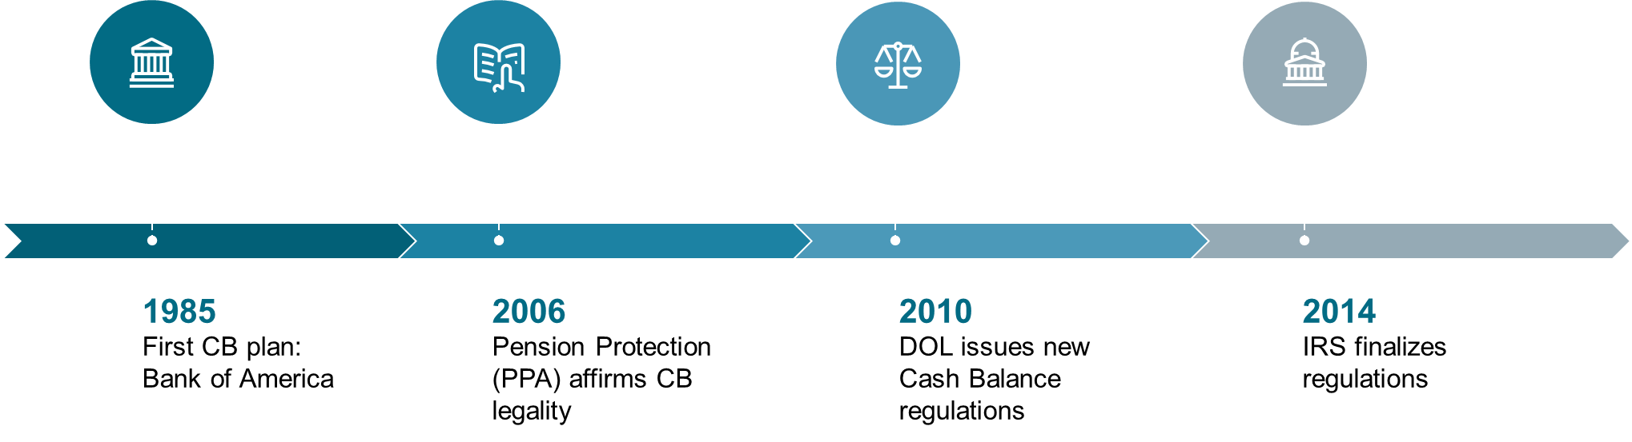
Since 1985

Slide 6
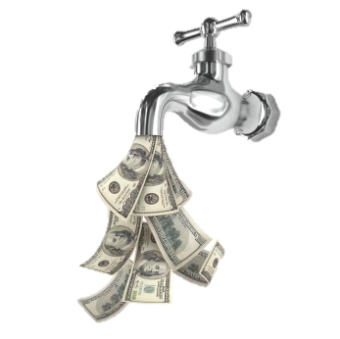



Two Key Differences
401(k)
Cash Balance
Interest
Crediting
Rate
The rate of interest
the plan promises
itself in the
Plan Document
Earnings
Contribution
Contribution

Slide 7

CASE STUDY
Meet Albert and
Sandy
Business Partners at an Engineering Firm
The information contained herein is provided only for the intended audience and not for use with or distribution to the general public.

Slide 8
Small Company
CASE STUDY
2 Owners | Age | Salary
Albert Jones | 60 | $350,000
Sandy Calloway | 40 | $350,000
10 Staff
Brandon Byrd | 59 | $135,000
Sarah Droste | 48 | $120,000
Ryan Oster | 45 | $100,000
Jimmy Bond | 41 | $75,000
Kelly Martinez | 32 | $70,000
John Lehman | 35 | $50,000
Liz Corola | 37 | $45,000
Drew College | 27 | $40,000
Zach Yi | 25 | $35,000
Angela Jordan | 32 | $25,000

Slide 9
Maximum 401(k)*
Case study
Name | Age | Annual Salary | 401(k) | Profit Sharing | Total Contribution
2 Owners
Albert Jones | 60 | $350,000 | $34,750 | $46,500 | $81,250
Sandy Calloway | 40 | $350,000 | $23,500 | $46,500 | $70,000
Subtotals |  | $700,000 | $58,250 | $93,000 | $151,250
10 Staff |  |  |  | 5% of pay
Brandon Byrd | 59 | $135,000 |  | $6,750
Sarah Droste | 48 | $120,000 |  | $6,000
Angela Jordan | 32 | $25,000 |  | $1,250
Subtotal |  | $695,000 |  | $34,750
*Important: This is a hypothetical example. If you want to obtain your own, or your client’s personalized scenario, please provide FuturePlan with a full, up-to-date owner and employee census in order to receive a customized plan design illustration. FuturePlan by Ascensus does not provide tax, legal, or accounting advice. This material has been prepared for informational and illustrative purposes only, and is not intended to provide, and should not be relied on for, tax, legal, or accounting advice. You or your client should consult your/their own tax, legal, and accounting advisors before engaging in any transaction. FuturePlan by Ascensus provides plan design, administration, and compliance services. It is not a broker-dealer or an investment advisor and does not provide tax, legal, or accounting services. Illustration may include the super catch-up for individuals aged 60-63. (SEE ADDITIONAL DISCLOSURES IN PRESENTATION.)

Slide 10
Add Cash Balance*
Case study
Name | Age | Annual Salary | 401(k) | Profit Sharing | Cash Balance
2 Owners
Albert Jones | 60 | $350,000 | $34,750 | $46,500 | $0 to $325,273
Sandy Calloway | 40 | $350,000 | $23,500 | $46,500 | $0 to $119,915
Subtotals |  | $700,000 | $58,250 | $93,000 | $444,188
10 Staff |  |  |  | 7.5% of pay
Brandon Byrd | 59 | $135,000 |  | $10,125 | $1,000
Sarah Droste | 48 | $120,000 |  | $9,000 | $1,000
Angela Jordan | 32 | $25,000 |  | $1,875 | $1000
Subtotal |  | $695,000 |  | $53,190 | $10,000
*Important: This is a hypothetical example. If you want to obtain your own, or your client’s personalized scenario, please provide FuturePlan with a full, up-to-date owner and employee census in order to receive a customized plan design illustration. FuturePlan by Ascensus does not provide tax, legal, or accounting advice. This material has been prepared for informational and illustrative purposes only, and is not intended to provide, and should not be relied on for, tax, legal, or accounting advice. You or your client should consult your/their own tax, legal, and accounting advisors before engaging in any transaction. FuturePlan by Ascensus provides plan design, administration, and compliance services. It is not a broker-dealer or an investment advisor and does not provide tax, legal, or accounting services. (SEE ADDITIONAL DISCLOSURES IN PRESENTATION.)

Slide 11
Add Modest Cash Balance*
CASE STUDY
Name | Age | Annual Salary | 401(k) | Profit Sharing | Cash Balance | Total Contribution
2 Owners
Albert Jones | 60 | $350,000 | $34,750 | $46,500 | $65,000 | $146,250
Sandy Calloway | 40 | $350,000 | $23,500 | $46,500 | $65,000 | $135,000
Subtotals |  | $700,000 | $58,250 | $93,000 | $130,000 | $281,250
10 Staff |  |  |  | 5% of pay
Brandon Byrd | 59 | $135,000 |  | $6,750 | $0
Sarah Droste | 48 | $120,000 |  | $6,000 | $0
 |  |  |  |  | $0
Angela Jordan | 32 | $25,000 |  | $1,250 | $571
Subtotal |  | $695,000 |  | $34,750 | $1,930
*Important: This is a hypothetical example. If you want to obtain your own, or your client’s personalized scenario, please provide FuturePlan with a full, up-to-date owner and employee census in order to receive a customized plan design illustration. FuturePlan by Ascensus does not provide tax, legal, or accounting advice. This material has been prepared for informational and illustrative purposes only, and is not intended to provide, and should not be relied on for, tax, legal, or accounting advice. You or your client should consult your/their own tax, legal, and accounting advisors before engaging in any transaction. FuturePlan by Ascensus provides plan design, administration, and compliance services. It is not a broker-dealer or an investment advisor and does not provide tax, legal, or accounting services.
(SEE ADDITIONAL DISCLOSURES IN PRESENTATION.)

Slide 12
40% Test*
CASE STUDY
Name | Age | Annual Salary | 401(k) | Profit Sharing | Cash Balance | Total Contribution
2 Owners
Albert Jones | 60 | $350,000 | $34,750 | $46,500 | $324,273 | $405,523
Sandy Calloway | 40 | $350,000 | $23,500 | $46,500 | $119,915 | $189,915
Subtotals |  | $700,000 | $58,250 | $93,000 | $444,188 | $595,438
10 Staff |  |  |  | 7.5% of pay
Brandon Byrd | 59 | $135,000 |  | $10,125
Sarah Droste | 48 | $120,000 |  | $9,000
Ryan Oster | 45 | $100,000 |  | $7,500
Jimmy Bond | 41 | $75,000 |  | $5,625
Kelly Martinez | 32 | $70,000 |  | $5,250
John Lehman | 35 | $50,000 |  | $3,750
Liz Corola | 37 | $45,000 |  | $3,375
Drew College** | 27 | $40,000 |  | $3,034 | $751
Zach Yi | 25 | $35,000 |  | $2,625 | $608
Angela Jordan | 32 | $25,000 |  | $1,875 | $571

Slide 13
Younger Owners / Age-Disparity*
CASE STUDY
Name | Age | Annual Salary | 401(k) | Profit Sharing | Cash Balance
2 Owners
Albert Jones | 45 | $350,000 | $23,500 | $46,500 | $133,765
Sandy Calloway | 35 | $350,000 | $23,500 | $46,500 | $90,000
Subtotals |  | $700,000 | $47,000 | $93,000 | $223,765
10 Staff |  |  |  | 5% of pay
Brandon Byrd | 59 | $135,000 |  | $6,750 | $0
Sarah Droste | 48 | $120,000 |  | $6,000 | $0
Angela Jordan | 32 | $25,000 |  | $2,698 | $571
*Important: This is a hypothetical example. If you want to obtain your own, or your client’s personalized scenario, please provide FuturePlan with a full, up-to-date owner and employee census in order to receive a customized plan design illustration. FuturePlan by Ascensus does not provide tax, legal, or accounting advice. This material has been prepared for informational and illustrative purposes only, and is not intended to provide, and should not be relied on for, tax, legal, or accounting advice. You or your client should consult your/their own tax, legal, and accounting advisors before engaging in any transaction. FuturePlan by Ascensus provides plan design, administration, and compliance services. It is not a broker-dealer or an investment advisor and does not provide tax, legal, or accounting services.(SEE ADDITIONAL DISCLOSURES IN PRESENTATION.)

Slide 14
A Solo Plan*
CASE STUDY
Name | Age | Annual Salary | 401(k) | Profit Sharing | Cash Balance
1 Owner
Jones | 50 | $350,000 | $31,000 | $21,000 | $197,024
Total |  | $350,000 | $31,000 | $21,000 | $197,024
Name | Age | Annual Salary | 401(k) | Profit Sharing | Cash Balance
2 Owners
Jones | 50 | $350,000 | $31,000 | $21,000 | $197,024
Jones Spouse | 50 | $35,000 | $31,000 | $2,100 | $30,000
Subtotals |  | $385,000 | $62,000 | $23,100 | $227,024
*Important: This is a hypothetical example. If you want to obtain your own, or your client’s personalized scenario, please provide FuturePlan with a full, up-to-date owner and employee census in order to receive a customized plan design illustration. FuturePlan by Ascensus does not provide tax, legal, or accounting advice. This material has been prepared for informational and illustrative purposes only, and is not intended to provide, and should not be relied on for, tax, legal, or accounting advice. You or your client should consult your/their own tax, legal, and accounting advisors before engaging in any transaction. FuturePlan by Ascensus provides plan design, administration, and compliance services. It is not a broker-dealer or an investment advisor and does not provide tax, legal, or accounting services. (SEE ADDITIONAL DISCLOSURES IN PRESENTATION.)

Slide 15
Many Owners*
CASE STUDY
Name | Age | Annual Salary | 401(k) | Profit Sharing | Cash Balance
8 Owners
Albert Jones | 70 | $350,000 | $31,000 | $21,000 | $368,438
Sandy Calloway | 65 | $350,000 | $31,000 | $21,000 | $335,982
Brandon Byrd | 60 | $350,000 | $34,750 | $21,000 | $324,273
Sarah Droste | 55 | $350,000 | $31,000 | $21,000 | $252,716
Ryan Oster | 50 | $350,000 | $31,000 | $21,000 | $197,024
Jimmy Bond | 45 | $350,000 | $23,500 | $21,000 | $153,672
Kelly Buckner | 40 | $350,000 | $23,500 | $21,000 | $119,915
Amy Conway | 35 | $350,000 | $23,500 | $21,000 | $93,618
Subtotal |  | $2,800,000 | $229,250 | $168,000 | $1,845,638
*Important: This is a hypothetical example. If you want to obtain your own, or your client’s personalized scenario, please provide FuturePlan with a full, up-to-date owner and employee census in order to receive a customized plan design illustration. FuturePlan by Ascensus does not provide tax, legal, or accounting advice. This material has been prepared for informational and illustrative purposes only, and is not intended to provide, and should not be relied on for, tax, legal, or accounting advice. You or your client should consult your/their own tax, legal, and accounting advisors before engaging in any transaction. FuturePlan by Ascensus provides plan design, administration, and compliance services. It is not a broker-dealer or an investment advisor and does not provide tax, legal, or accounting services.
(SEE ADDITIONAL DISCLOSURES IN PRESENTATION.)

Slide 16
Highly-Paid Non-Owner Option*
CASE STUDY
Name | Age | Annual Salary | 401(k) | Profit Sharing | Cash Balance
2 Owners
Albert Jones | 60 | $350,000 | $34,750 | $46,500 | $137,000
Sandy Calloway | 40 | $350,000 | $23,500 | $46,500 | $26,000
Subtotals |  | $700,000 | $58,250 | $93,000 | $163,000
1 Highly Compensated Employee |  |  |  | 3% of pay
Brandon Byrd | 59 | $251,000 |  | $7,530
9 Staff |  |  |  | 7.5% of pay
Sarah Droste | 48 | $120,000 |  | $9,000 | $0
Ryan Oster | 45 | $100,000 |  | $7,500 | $0
Jimmy Bond | 41 | $75,000 |  | $5,625 | $0
Kelly Martinez | 32 | $70,000 |  | $5,250 | $0
John Lehman | 35 | $50,000 |  | $3,750 | $0
Liz Corola | 37 | $45,000 |  | $3,375 | $0
Drew College | 27 | $40,000 |  | $3,000 | $751
Zach Yi | 25 | $35,000 |  | $2,625 | $608
Angela Jordan | 32 | $25,000 |  | $1,875 | $571

Slide 17

A lean year
Contribution amounts can be adjusted
Amend, Freeze, Terminate
  By mid-year
CB contribution tied to W-2 pay
Maintain OVER/UNDER-funded plan
The information contained herein is provided only for the intended audience and not for use with or distribution to the general public.

Slide 18

ENTITY TYPES
S-Corp
C-Corp
Partnership
LLC
All entities can work with a Cash Balance plan
The information contained herein is provided only for the intended audience and not for use with or distribution to the general public.

Slide 19
TOP CANDIDATES
Medical Groups and Law Firms
ANY business owner $350,000+
1:10 owner to employee ratio
You hear these words:
“I want a larger tax deduction”
“I want to do more than the $70,000 in 401(k)”
“ We are maxing out our 401(k) Plan”
The information contained herein is provided only for the intended audience and not for use with or distribution to the general public.

Slide 20
Plan Cash Flow*
Case study
Name | Age | Annual Salary | 401(k) | Profit Sharing | Cash Balance
2 Owners
Albert Jones | 60 | $350,000 | $34,750 | $46,500 | $0 to $325,273
Sandy Calloway | 40 | $350,000 | $23,500 | $46,500 | $0 to $119,915
Subtotals |  | $700,000 | $58,250 | $93,000 | $444,188
10 Staff |  |  |  | 7.5% of pay | Meaningful Benefit
Brandon Byrd | 59 | $135,000 |  | $10,125 | $1,000
Sarah Droste | 48 | $120,000 |  | $9,000 | $1,000
Angela Jordan | 32 | $25,000 |  | $1,875 | $1000
Subtotal |  | $695,000 |  | $53,190 | $10,000
*Important: This is a hypothetical example. If you want to obtain your own, or your client’s personalized scenario, please provide FuturePlan with a full, up-to-date owner and employee census in order to receive a customized plan design illustration. FuturePlan by Ascensus does not provide tax, legal, or accounting advice. This material has been prepared for informational and illustrative purposes only, and is not intended to provide, and should not be relied on for, tax, legal, or accounting advice. You or your client should consult your/their own tax, legal, and accounting advisors before engaging in any transaction. FuturePlan by Ascensus provides plan design, administration, and compliance services. It is not a broker-dealer or an investment advisor and does not provide tax, legal, or accounting services. Illustration may include the super catch-up for individuals aged 60-63. (SEE ADDITIONAL DISCLOSURES IN PRESENTATION.)

Slide 21
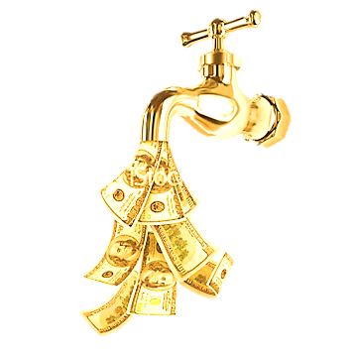
Interest Crediting Rate
Cash Balance
Interest
Crediting
Rate
(4-5%)
Dictated by Plan Document
Contribution

Slide 22
Fixed Rate: 4%
4% ICR
Performance
Notes:
What options are there on which ICR to choose?
The rate on the 30-Year Treasury is one. For many years this has been quite low.
Fixed rates are more common. 4% is the most common.
But there is a new option called Actual Rate of Return which ties the credit (ICR) to the actual performance of the portfolio. This means there will rarely, if ever, be a shortfall.

Slide 23
Fixed Rate ICR
OVERfunded
Can reduce contribution
Pay actuarial fees
One-time special allocation at end of plan
Earnings
UNDERfunded
Forgo benefit: small plan
Catch up
Possible notices / PBGC premium
Earnings
15-Year
Smoothing Period

Slide 24
Actual Rate of Return
The Actual Annual Return of the CB Portfolio
Principal Balance
Performance
Notes:
What options are there on which ICR to choose?
The rate on the 30-Year Treasury is one. For many years this has been quite low.
Fixed rates are more common. 4% is the most common.
But there is a new option called Actual Rate of Return which ties the credit (ICR) to the actual performance of the portfolio. This means there will rarely, if ever, be a shortfall.

Slide 25
Actual Rate of Return
OVERfunded
UNDERfunded
Principal Preservation Rule
e.g. $100,000 contributed over 3 years
– owed at least $300,000

Slide 26
ARR Doesn’t Fit Everywhere
CASH BALANCE
Larger plans
If non-discrimination testing passes easily
If sponsor can tolerate larger/smaller contributions to employees in the CB Plan

Slide 27

Investment Considerations
The Plan has ONE account
  Actuary is recordkeeper
At R/K or broker/dealer
You consult with business owner / committee
  ICR
  Risk tolerance
  Funding tolerance
  Tax deduction tolerance
Not Intended as Tax, Legal or Investment Advice. Consult with your tax, legal or financial advisor.
The information contained herein is provided only for the intended audience and not for use with or distribution to the general public.

Slide 28
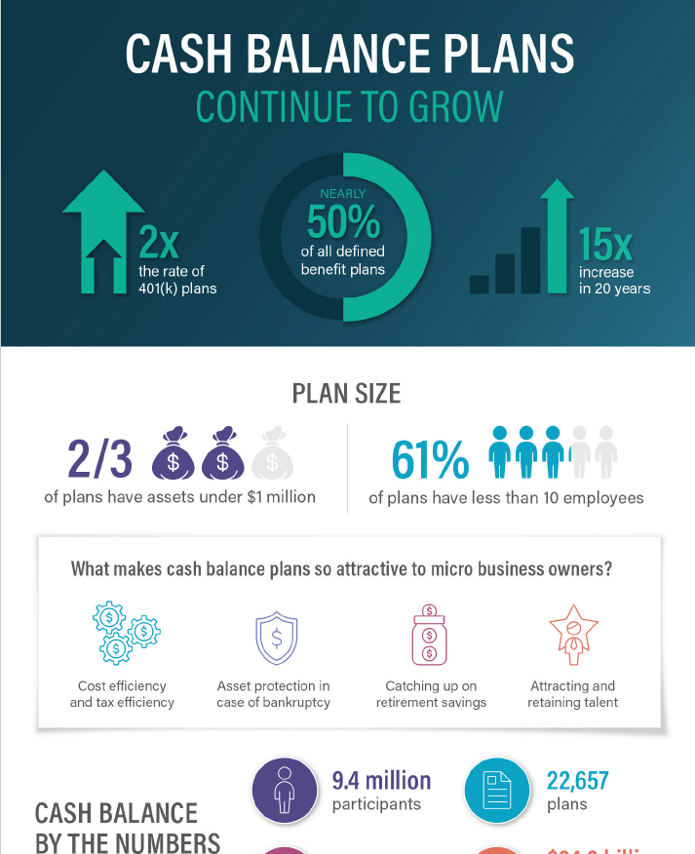

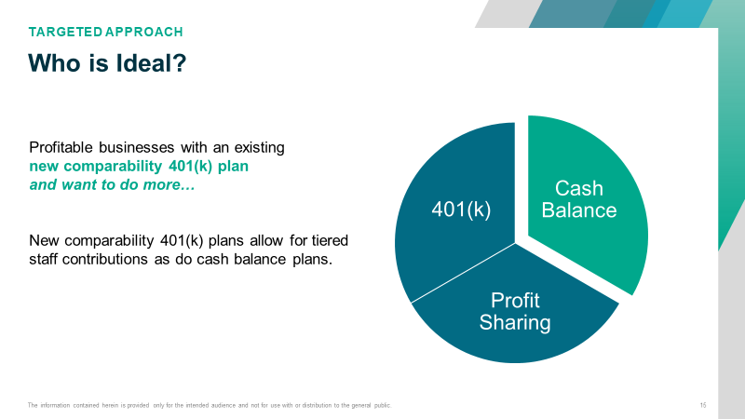
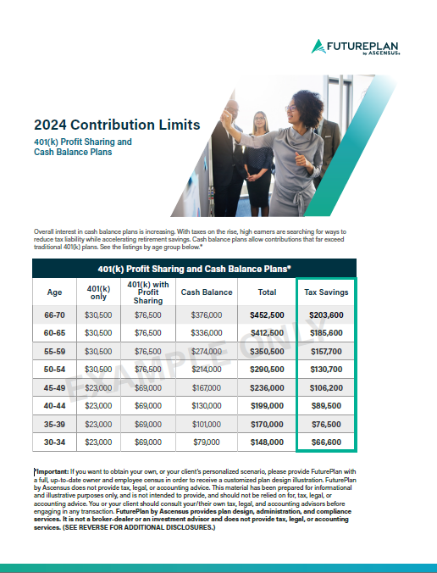


Marketing Partnership and Resources
Local programs
  CPA CPE program
  “30-minute update” webinars
  “How to Sell Large Plans”
Product flyers
Beyond The 401(k) book
The information contained herein is provided only for the intended audience and not for use with or distribution to the general public.

Slide 29

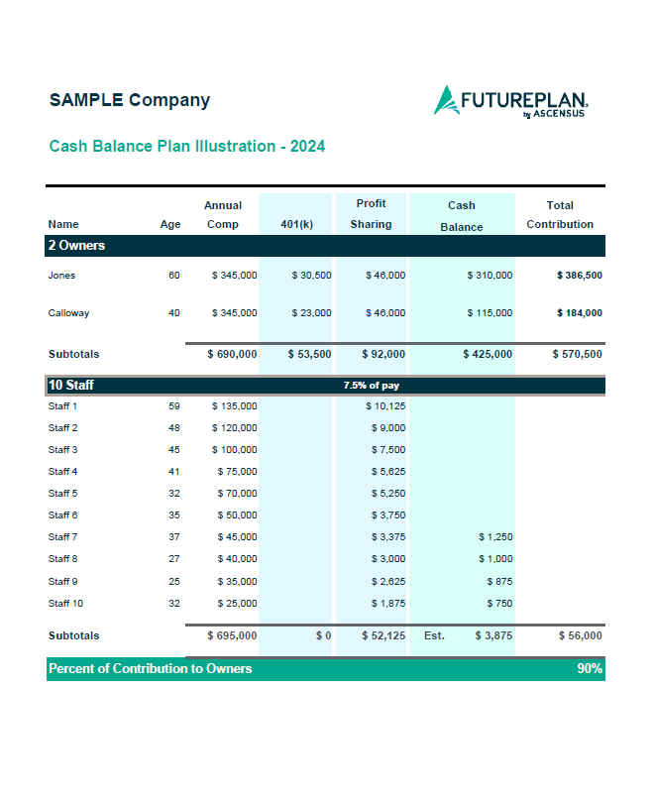

Sales Partnership with FuturePlan
Quality and Speedy Illustrations
Zoom or Conference Call (bring us in early and often)
The information contained herein is provided only for the intended audience and not for use with or distribution to the general public.

Slide 30
Thank you

Slide 31
Information and disclosures (plan limits & illustrations*)
*(Plan Limits) $23,500 for 401(k) plan; $7,500 catch-up (age 50 or older); $46,500 profit sharing. Amounts shown in the chart do not include the additional catch-up contributions for participants aged 60-63. This hypothetical chart assumes a 45% tax bracket of combined federal and state taxes and taxes are deferred. The following assumptions also apply:
Maximum annual contribution amounts for the cash balance/defined benefit plan are calculated using 4% interest rates and assuming no pre-retirement mortality and using the latest available applicable mortality tables.
The maximum cash balance amounts assume a 3-year average compensation of at least $280,000 (the maximum annuity limit for 2025), and prior years of service.
The amounts needed to fund the cash balance/defined benefit plan may be reduced by a participant’s prior highest 3-year salary history if it is less than the IRS maximum annuity limit (as shown above) or below the IRS maximum compensation limits under 401(a)(17) (e.g., $350,000 for 2025, $345,000 for 2024, etc.) and other deduction limits may apply.
The amounts needed to fund in the cash balance/defined benefit plan will also be reduced if a participant participated in any prior cash balance/defined benefit plan of the employer or a related employer.
Further, amounts shown may be reduced if the cash balance/defined benefit plan is not covered by the Pension Benefit Guaranty Corporation (PBGC), which may limit the amount available to fund in any paired 401(k) profit sharing plan of the employer. (Plans typically not covered by the PBGC are professional service businesses with fewer than 26 active participants.)
It is also important to note that amounts shown are estimates and will vary depending on an employer’s demographics of owners and employees along with a myriad of other factors and considerations.
Important: if you want to obtain your own, or your client’s personalized scenario, please provide FuturePlan with a full, up-to-date owner and employee census in order to receive a customized plan design illustration. FuturePlan by Ascensus does not provide tax, legal, or accounting advice. This material has been prepared for informational and illustrative purposes only, and is not intended to provide, and should not be relied on for, tax, legal, or accounting advice. You or your client should consult your/their own tax, legal, and accounting advisors before engaging in any transaction.

Slide 32
Information and disclosures (cont.)
FuturePlan by Ascensus provides plan design, administration, and compliance services. It is not a broker-dealer or an investment advisor and does not provide tax, legal, or accounting services.
Information provided in this presentation is for informational purposes only and should not be construed as an offer or solicitation of an offer to buy or sell securities. Furthermore, investing in such securities involves substantial risk of loss and investors should seek advice from financial professionals before investing.
Ascensus® and the Ascensus logo are registered trademarks of Ascensus, LLC.
Copyright ©2025 Ascensus, LLC. All Rights Reserved.
2144601-FUT-2144602ML

